Slide 1


LEADERSHIP
Nitesh Rajput
BCA 4M
01514202023

Slide 2
What is leadership?

Slide 3
Leadership
•Leadership is guiding and inspiring others.
• It is about making decisions for the greater good.

Slide 4
Leadership is everywhere
Politics
Business
The military
even in our daily lives.

Slide 5
Leadership style & its type
Autocratic Leadership
Democratic Leadership
Delegative Leadership

Slide 6
Who is Leader?
A leader is someone who inspires passion and motivation followers
They put their people first and lead with example

Slide 7
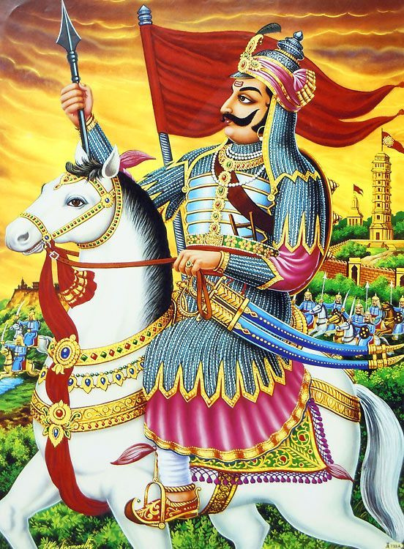
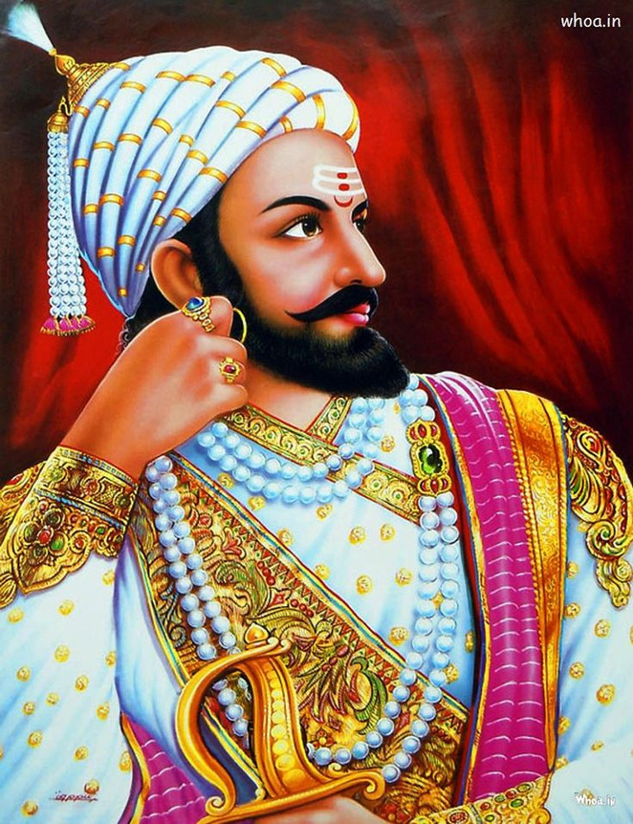
Some true leader

Slide 8
Key Leadership Qualities
Courage
Vision
Honesty
Hard Work
Responsibility
Decision-Making
Kindness

Slide 9
Key Leadership Qualities
Courage – The First Step to Leadership
Leaders face challenges without fear.
Example: Maharana Pratap never surrendered, even when facing hardships.

Slide 10
Key Leadership Qualities
Vision – Seeing the Bigger Picture
A leader must plan for the future and set goals.
Example: Shivaji created a strong naval force to protect his kingdom

Slide 11
Key Leadership Qualities
Honesty and Integrity
A leader must be truthful and stand by their values.
Example: Maharana Pratap refused to surrender for personal gain

Slide 12
Key Leadership Qualities
Hard Work and Dedication
Success comes from continuous effort
Example: Shivaji worked hard to train his army and build forts

Slide 13
Key Leadership Qualities
Kindness and Care for People
A leader should care for the well-being of others
Example: Maharana Pratap always ensured his people’s safety and honor.

Slide 14
How to Develop Leadership Skills
•- Be confident and take responsibility.
•- Improve decision-making and communication skills.
•- Learn from Role Models

Slide 15
Conclusion – Be a Leader in Life
•- Leadership is about courage, vision, and responsibility.
•- Anyone can be a leader by making the right choices.
•- Follow the path of great leaders and inspire others!

Slide 16
Thank You

